Slide 1

PROJECT NAME: SCIENTIFIC UNIT CONVERTER
SUBMITED BY: GUIDENCE/SUBMITED TO:
Ujjwal Puri Goswami MISS.NAINA DEVI
1ST SEMESTER IBM
BTECH CSE (AI/ML) SESSION:2025-26
SECTION: B
IBM

Slide 2
📌AGENDA
🔢 To design a menu-driven unit conversion program using C
To perform temperature conversions
📏 To convert distance units
⚖️ To convert mass units
⏱️ To convert time units
💡 To demonstrate the use of switch–case and nested logic

Slide 3
🎯 OBJECTIVE
💻 To understand the structure of a C program
🔁 To implement switch–case statements effectively
📥 To take user input and process it correctly
To apply logical and mathematical operations
📊 To provide accurate and fast unit conversions
🚀 To enhance problem-solving and coding skills

Slide 4
🧾 INTRODUCTION TO PROJECT
Scientific Unit Converter Using c program
👋 Overview
The Scientific Unit Converter is a console-based C application designed to convert different scientific units in an easy and efficient manner.
💡 Purpose
This project helps users convert units related to Temperature, Distance, Mass, and Time using simple menu options. It also helps students understand practical implementation of switch–case statements in C programming.
⚙️ Working Principle
The program first asks the user to select a category, then a conversion type, and finally the input value. Based on the selection, the program performs the required calculation and displays the result.
🎯 Application
This type of converter is useful in education, laboratories, engineering calculations, and daily-life unit conversions.

Slide 5


🛠️ TOOLS & TECHNOLOGIES USED
💻 Visual Studio Code (VS Code)
Used for writing and editing the C source code.
⚙️ GCC Compiler
Compiles and executes the C program.
⌨️ C Programming Language
Used to implement logic, conditions, and calculations.
🖥️ Windows Operating System
Provides the execution environment.

Slide 6
⚙️ PROJECT WORKING
1️⃣ 📂 Category Selection
User selects a category like Temperature, Distance, Mass, or Time.
2️⃣ 🔁 Conversion Choice
User chooses a specific conversion type from the menu.
3️⃣ 📥 Input Value
User enters the value to be converted.
4️⃣ 🧠 Logic Execution
The program uses switch–case statements to perform calculations.
5️⃣ 📊 Result Display
Converted value is displayed with accuracy.

Slide 7
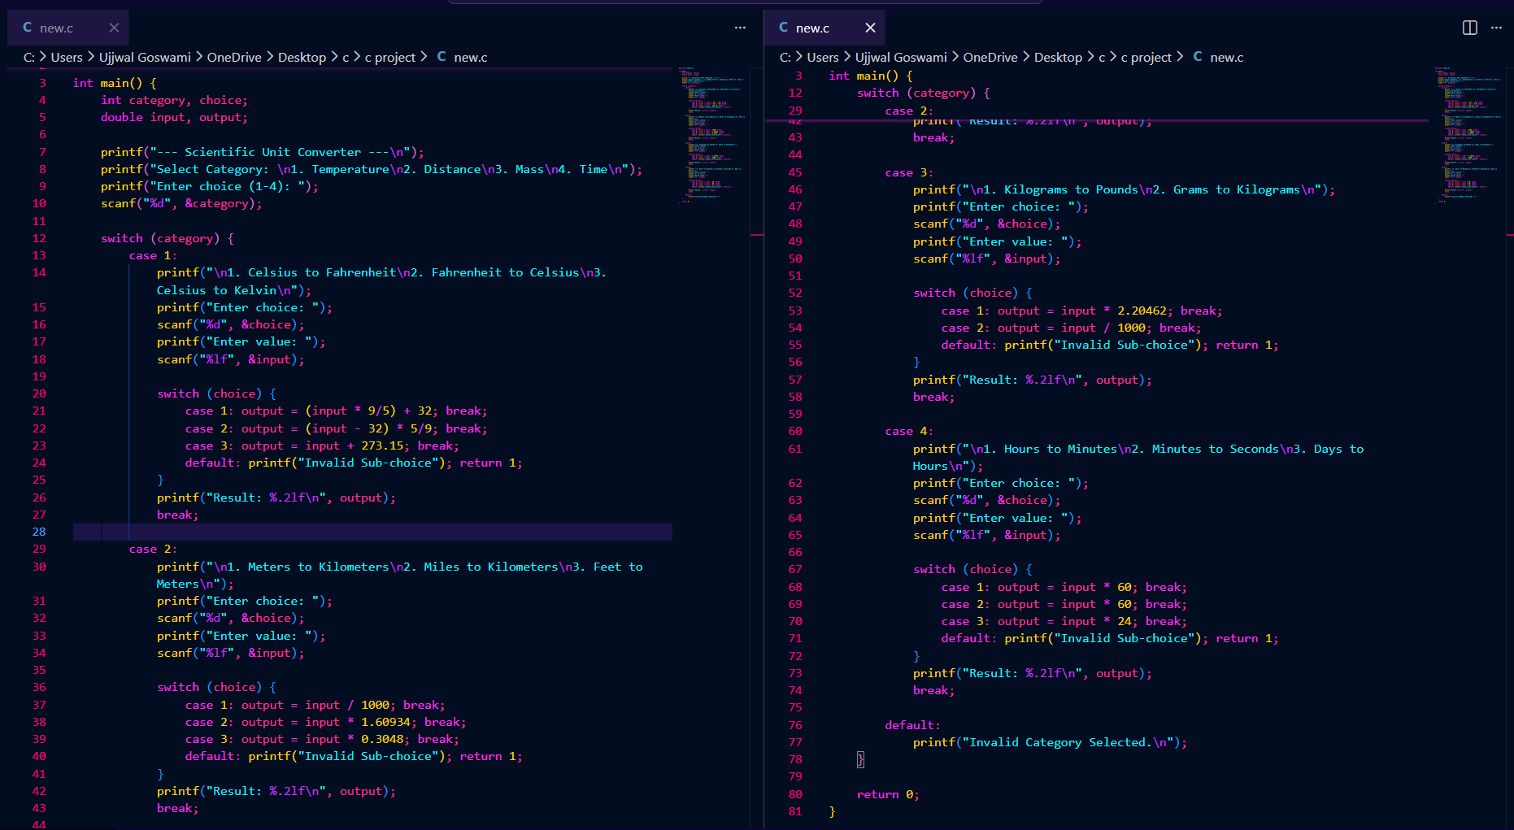
📸 SCREENSHOT

Slide 8
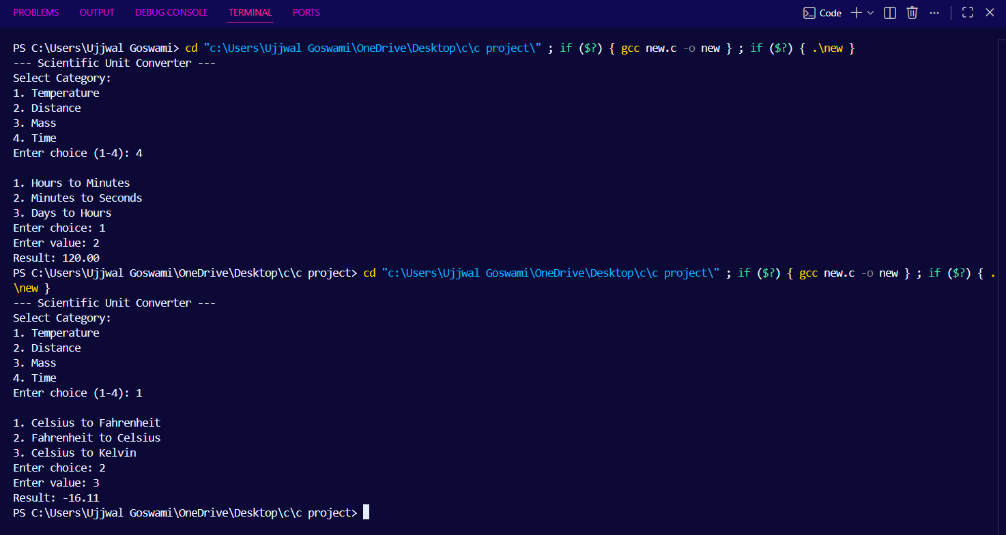
📊 Output

Slide 9

✅ Advantage of Scientific Unit Converter
1️⃣ Easy to Use 👍
Simple menu-driven interface.
2️⃣ Fast Conversion ⚡
Instant results without manual calculation.
3️⃣ Accurate Results 🎯
Reduces human calculation errors.
4️⃣ Educational 📘
Helps beginners learn C programming concepts.
5️⃣ Reusable ♻️
Can be modified to add more conversions.

Slide 10
🔮 Future Scope of Scientific Unit Converter
1️⃣ Add More Units 📐
Area, Volume, Speed, Energy, etc.
2️⃣ GUI-Based Application 🖥️
Convert it into a graphical application.
3️⃣ File Handling 💾
Store conversion history in files.
4️⃣ Web or Mobile Version 🌐
Develop as a web or mobile app.
5️⃣ Advanced Error Handling 🚨
Improve validation for invalid inputs.

Slide 11


